Slide 1


Java ee
(ADVANCE JAVA)
Lecture-6

Slide 2
Today’s Agenda
Recap Of Database Programming
Connecting A Servlet To The Database
Which Methods To Override And Why ?
Sample Code

Slide 3
RECAP OF DATABASE PROGRAMMING
It's hard to find a professional web site today that doesn't have some sort of database connectivity.
Java based sites are no different and so we have to learn how to connect a servlet to databases
Servlets, with their enduring life cycle, and JDBC, a well-defined database-independent database connectivity API, are an elegant and efficient solution for web developers who need to hook their web sites to back-end databases

Slide 4
RECAP OF DATABASE PROGRAMMING
The biggest advantage for servlets with regard to database connectivity is that the servlet life cycle allows servlets to maintain open database connections.
An existing connection can trim several seconds from a response time, compared to a CGI script that has to reestablish its connection for every invocation.
Exactly how to maintain the database connection depends on the task at hand, and this lecture covers the connected architecture of JDBC.

Slide 5
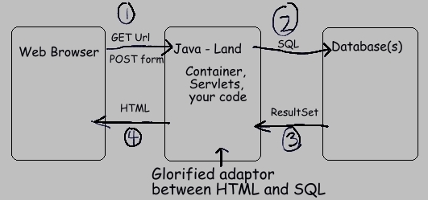
DIAGRAM

Slide 6
DATABASE PROGRAMMING IN SERVLETS
When we write a servlet and interact with database inside the servlet then we have to take three steps:
1. Open the connection to the database
(required only once)
2. Processing the request
(required on every request)
3. Disconnecting with the database
(required only once)

Slide 7
DIAGRAM
OPEN THE CONNECTION
PROCESS THE REQUEST
DISCONNECTING THE DATABASE

Slide 8
HOW TO IMPLEMENT STEP 2 ?
The coding for step 2 can be done in doGet( ) or doPost( ) method because request processing needs to be done in every request and i.e for every user visiting our site, we will execute a query and process the result.
Now since the doGet( ) and doPost( ) method are executed on each request so we will write request processing code in them .

Slide 9
HOW TO IMPLEMENT STEP 3 ?
The coding for step 3 which needs to be done only one time we can choose the method destroy( ) and override it because this method is called only once in the life cycle of a servlet which is when the server is shut down or due to some reason the servlet is stopped.

Slide 10
HOW TO IMPLEMENT STEP 1 ?
The coding for step1 which also needs to be done only one time can be done inside the init(ServletConfig) method. This is because the method init(servletConfig) is also called only once which is when the first request arrives.
But there is an important point to remember which is that the init(servletConfig) method has been already designed in our base class HttpServlet and there is some very important initialization code written into it.

Slide 11
HOW TO IMPLEMENT STEP 1 ?
Now, if we override init(ServletConfig) then the initialization code will not get a chance to run .
So java has recommend two solutions for this:
We can call the parent class version of init(ServletConfig) from our servlet init(ServletConfig) using the keyword super.
There is one more init( ) method which is having blank body inside HttpServlet the prototype of this init( ) is :
public void init() throws ServletException

Slide 12
HOW TO IMPLEMENT STEP 1 ?
And the parameterized version of init(ServletConfig ) defined inside HttpServlet class contains a call to non-parameterized version of init
So instead of overriding init(ServletConfig) we should override init() .

Slide 13
HOW TO IMPLEMENT STEP 1 ?
In this case both the init( ) methods will run.
At first the parameterized version of init( )will be called by the container and then from parameterised the non parameterized version init( )will be called.

Slide 14
EXERCISE
Suppose you have a table called USERS( userid,password,username) in the database having some records of registered users.
Write a web application containing the following:
An HTML page called login.html asking the user to input his userid and password.
A servlet called LoginServlet , which should be called by this HTML page , validate user credentials and if the user is present it should welcome the user with his registered username , other wise it should generate a link back to login.html page asking the user to try again

Slide 15
EXERCISE
Modify the previous exercise , so that if the login fails , your code provides the user the option to register as a new user by providing a link to register.html.
When the user clicks on his link , an HTML page should open asking the user to fill in the details . After filling the details the HTML page should call RegistrationServlet , which should add the record of the user in USERS table.

Slide 16
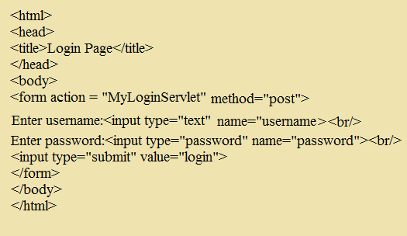
PROGRAM

Slide 17
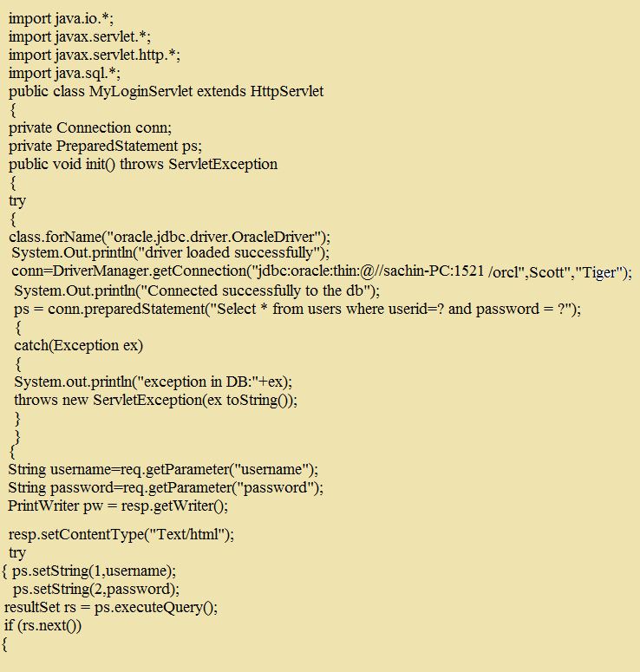
SERVLET CODE

Slide 18
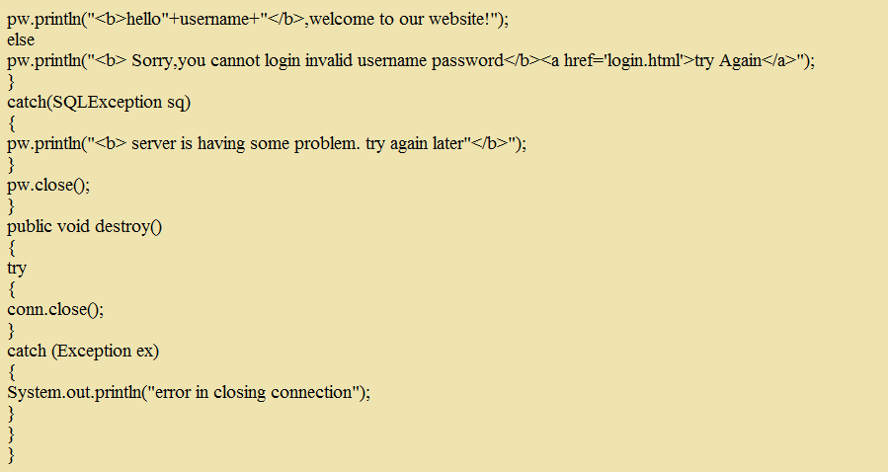
CONTI.

Slide 19

End Of Lecture
For any queries mail us @: scalive4u@gmail.com
Call us @ : 0755-4271659, 7879165533
Agenda for Next Lecture:
Initialization Parameters
Using servlet initialization parameters
Using context initialization parameters
Context Listeners
Improving the code with initialization parameters

